Slide 1
Vincent Lau
Professor, Department of Electronic and Computer Engineering
Wireless Communications with Channel Feedback

Slide 2
(Q1) Who Am I?

Slide 3
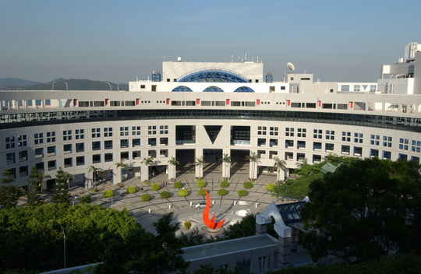
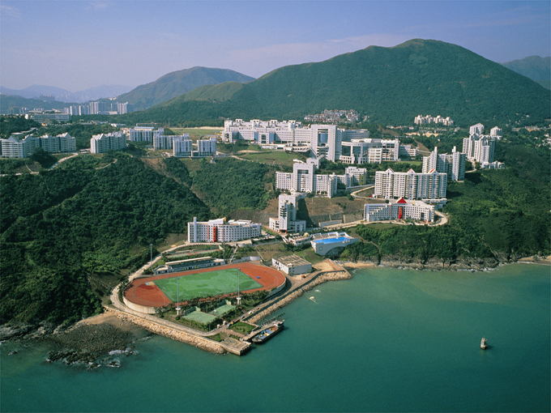
Brief Biography
B.Eng (1st Hons) Dept of ECE, University of Hong Kong (89-92)
System Engineer, HK Telecom (92-95)
Ph.D., Cambridge University (95-97)
Research Scientist, Bell Labs, New Jersey
Joined HKUST at 2004
Area of Interests
  Theoretical Research:
    Next Generation Wireless Communication Systems
    Cross Layer Radio Resource Optimization
  Applied Research and Technology Transfer:
    Long Term Evolution (LTE) and Beyond
    Next Generation WiFi Systems

Slide 4
(Q2) Why Wireless Communication is important?

Slide 5
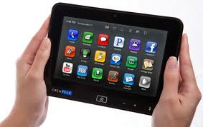
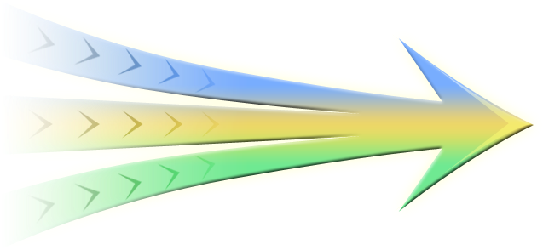
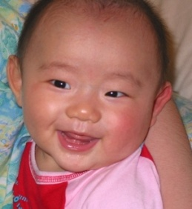
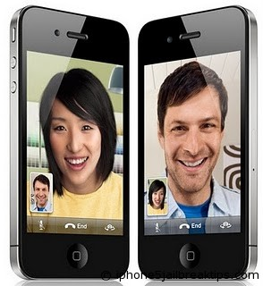




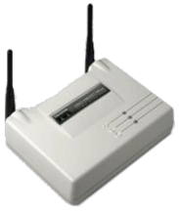

Wireless Everywhere
Social Networking
Voice
Mobile TV
Wireless Internet
SMS
WiFi
You Tube
Email
Today
Yesterday- 15 years ago
Billions of wireless devices
Millions of wireless devices

Slide 6






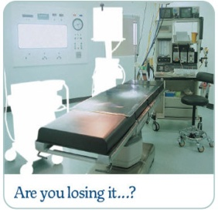


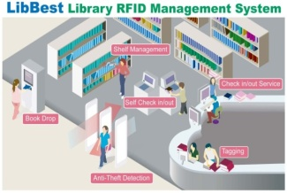
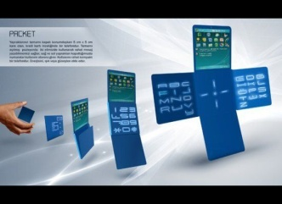
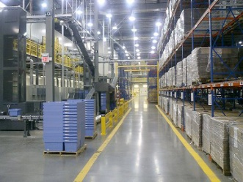
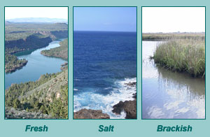
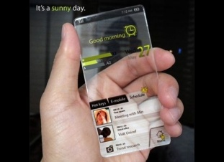
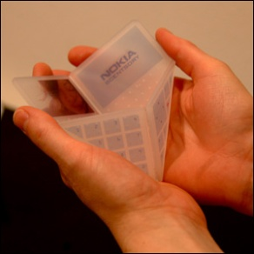
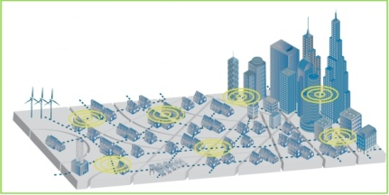

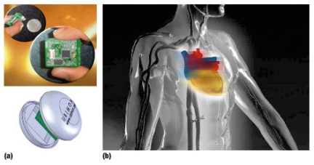
Wireless Everywhere
Cyber Physical Systems
Internet of Things
Environment
Energy
New Devices
Health Care
People to People
People to machines
Machines to Machines
Tomorrow +15 years
Trillions of Wireless devices

Slide 7
Cellular Systems
Today: 3G WCDMA Systems
  2Mbps peak bit rate
  Mobility < 200km/hr
Future: 4G Wireless Systems (LTE-A)
  >100Mbps bit rate
  Mobility ~ 480km/hr
Bit rate faster than a lot of existing fixed line ISP today!

Slide 8
(Q3) Why Wireless is Challenging?

Slide 9
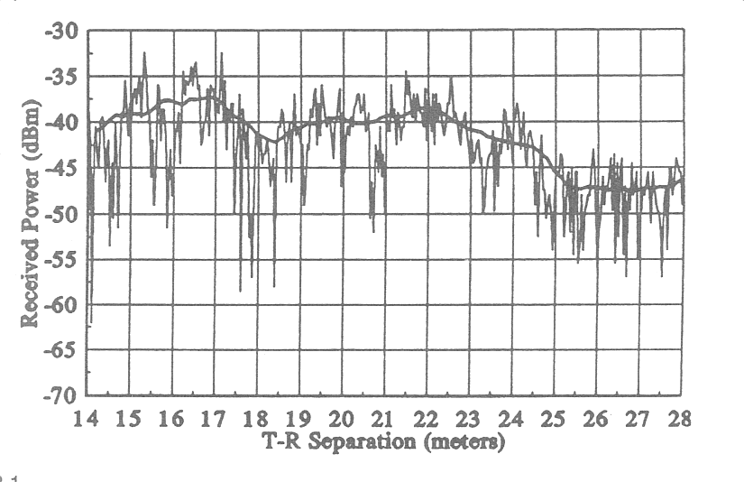
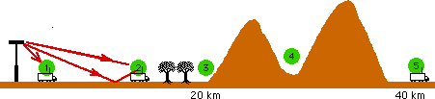
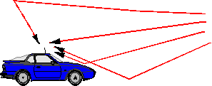
(1) Propagation Challenge
Fixed line communication
  Stable Time-Invariant channel
  Reliable communication (Physical BER ~ 10⁻¹⁰)
Wireless Communication
  Multipath Propagation → huge dynamic range
  Mobility → Time Varying channel (Physical BER ~ 0.1%)

Slide 10


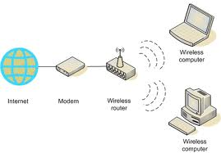
(2) Capacity Challenge
Transmitter
101001100111……..
Receiver
Transmitter
101001100111……..
Receiver
Transmitter
101001100111……..
Receiver
Bit rate demand increases → link becomes too slow
3 times bit rate!
(Q1) Can we double the capacity by installing one more base station?
No! Interference becomes the bottleneck
Need to time share or frequency share

Slide 11
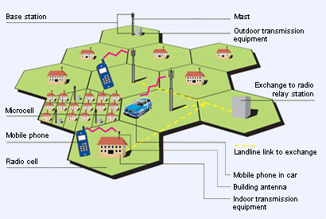
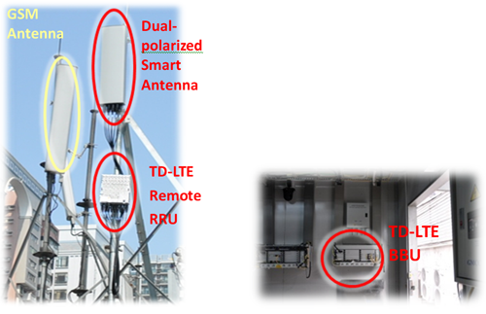
(3) Interference Challenge

Slide 12
(Q4) Benefit of Channel Feedback?

Slide 13
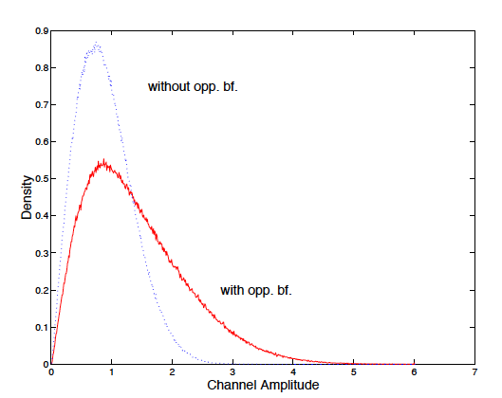
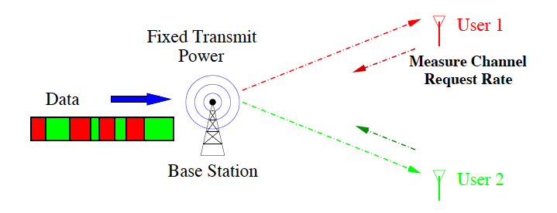
Wireless Communications with Channel Feedback
Link Level:- Opportunistic Transmission:-
Capture the “Good Channel Condition” to send more and add more protection for “Poor Channel Condition”.
(2) System Level:- Opportunistic Scheduling:-
Selects user(s) with the best channel condition to transmit.
(3) Network Level:- Interference Mitigation:-
Cooperative MIMO and Coordinated MIMO all requires channel condition feedback.

Slide 14
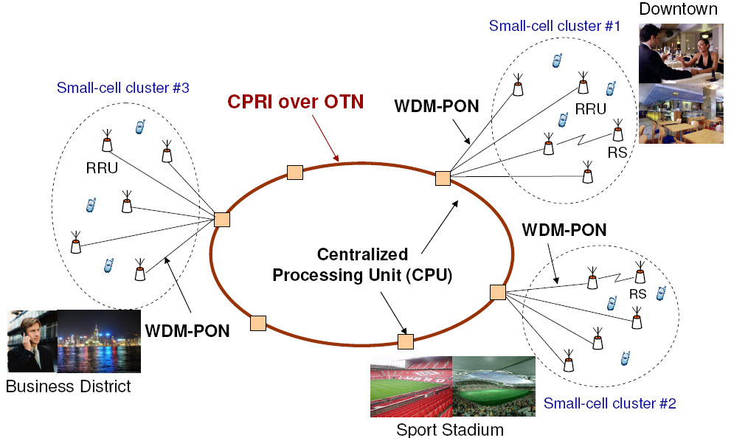
Future Trends
Cloud Radio Access Network
Large Scale MIMO Network
Green Wireless Infrastructure

Slide 15
Thank you very much

